Slide 1
Sequential Circuits

Slide 2
SEQUENTIAL CIRCUITS VS COMBINATIONAL CIRCUITS

Slide 3
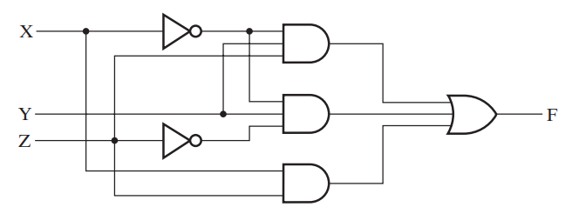
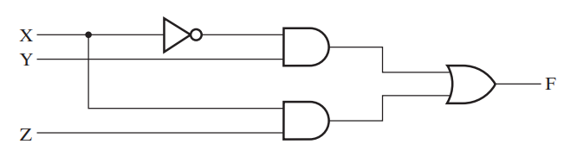
Sequential Circuits vs Combinational Circuits
Recall Combinational Circuits

Slide 4
Sequential Circuits vs Combinational Circuits
Recall Combinational Circuits

Slide 5
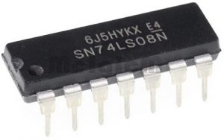
Sequential Circuits vs Combinational Circuits
Recall Combinational Circuits

Slide 6
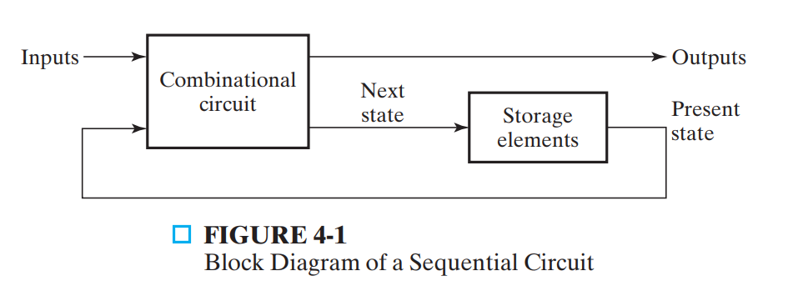
Sequential Circuits vs Combinational Circuits
What are Sequential Circuits ?
Think about a simple Addition Circuit with LED Display
8 bits
8 bits
8 bits
8 bits

Slide 7
Sequential Circuits vs Combinational Circuits
What are Sequential Circuits ?
Think about a simple Addition Circuit with LED Display
8 bits
8 bits
8 bits
8 bits

Slide 8
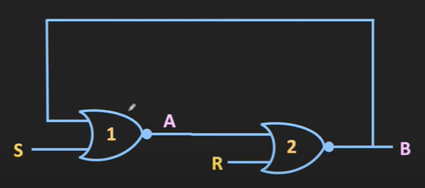
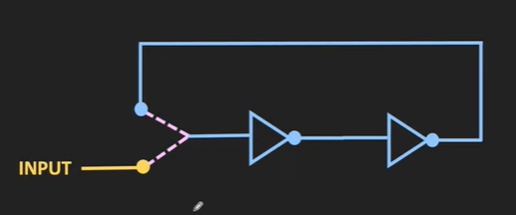
Sequential Circuits vs Combinational Circuits
We need to build an storage system
…One bit at a time

Slide 9
Sequential Circuits vs Combinational Circuits
We need to build an storage system
…One bit at a time
1
set
1
0
reset

Slide 10
Sequential Circuits vs Combinational Circuits
We need to build an storage system
…One bit at a time
0
set
1
0
reset

Slide 11
Sequential Circuits vs Combinational Circuits
We need to build an storage system
…One bit at a time
0
set
0
1
reset

Slide 12
Sequential Circuits vs Combinational Circuits
We need to build an storage system
…One bit at a time
0
set
0
0
reset

Slide 13
Sequential Circuits vs Combinational Circuits
We need to build an storage system
…One bit at a time
1
set
?
1
reset

Slide 14

Sequential Circuits vs Combinational Circuits
We need to build an storage system
…One bit at a time
1
set
?
1
reset

Slide 15
LET US TRY TO BUILD A ONE BIT STORAGE SYSTEM

Slide 16
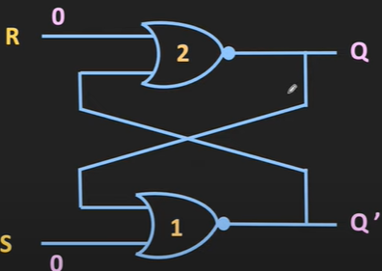
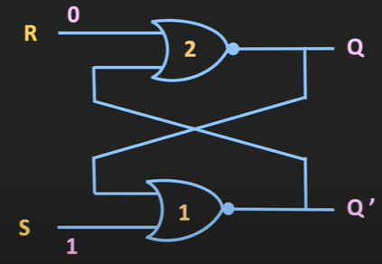
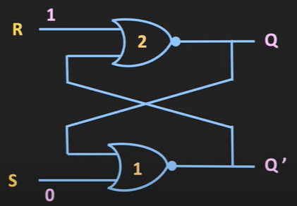
A One Bit Storage System
SR Latch

Slide 17
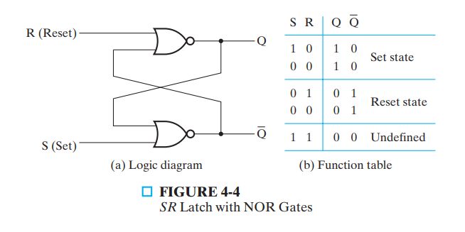
A One Bit Storage System
SR Latch

Slide 18
A One Bit Storage System
S’R’ Latch

Slide 19
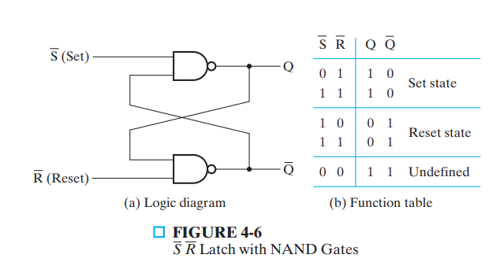
A One Bit Storage System
S’R’ Latch

Slide 20
A One Bit Storage System
Latch with a control signal

Slide 21
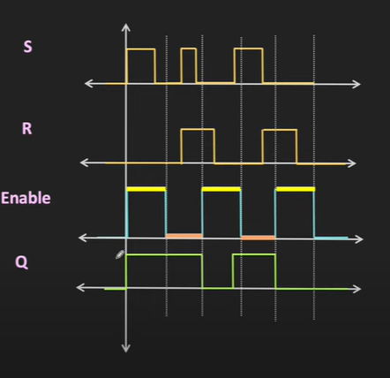
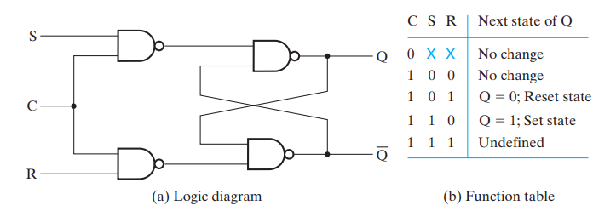
A One Bit Storage System
Latch with a control signal

Slide 22
A One Bit Storage System
D Latch (with control signal)

Slide 23
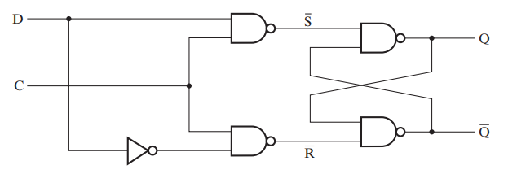
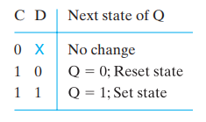
A One Bit Storage System
D Latch (with control signal)

Slide 24
WHAT IS A FLIP FLOP

Slide 25
Flip Flop
The storage elements used in the simplest form of clocked sequential circuits are called flip-flops.
A flip-flop is a binary storage device capable of storing one bit of information and having timing characteristic

Slide 26
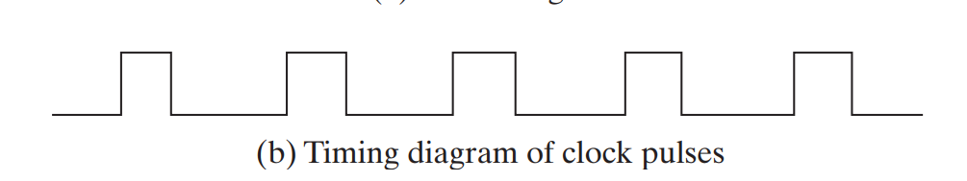
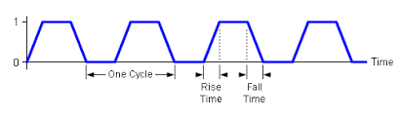
Flip Flop
Clock and Time?
Clock
Circuit

Slide 27
Flip Flop
Clock and Time?

Slide 28
Flip Flop
Clock and Time?

Slide 29
Flip Flop
Flip Flop
Clock
Circuit

Slide 30
Flip Flop
Triggers
Level Trigger:
A level-triggered event means that when the voltage reaches a particular level
Edge Trigger:
An edge-triggered event means that the event is triggered when the voltage is spotted rising or falling, which might be at the time marked.
Clock
Circuit

Slide 31
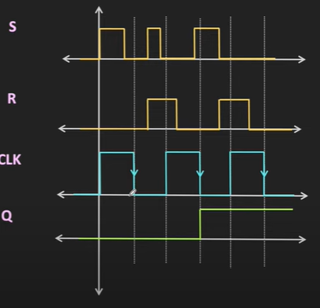
Flip Flop

Slide 32
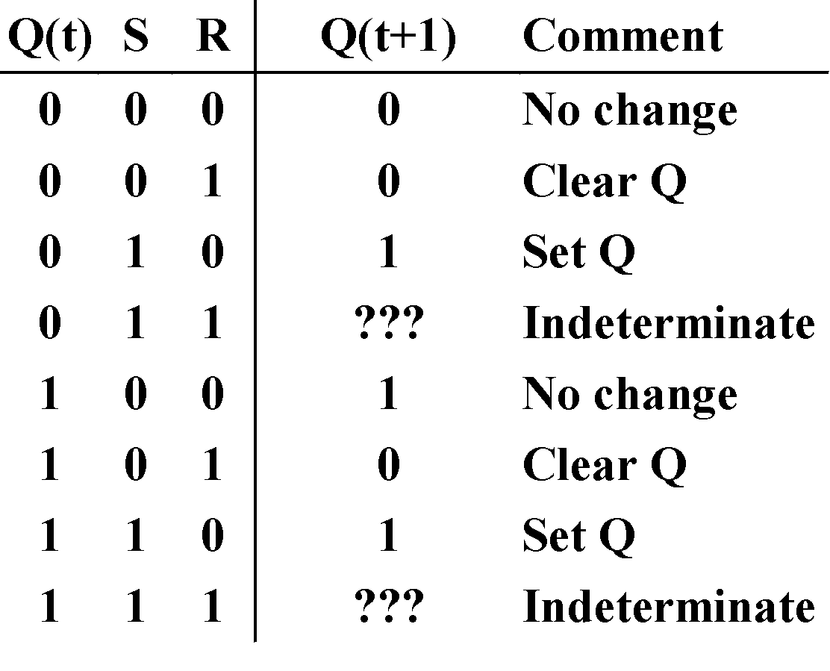
Clocked S - R Latch (continued)
The Clocked S-R Latch can be described by a table:
The table describes what happens after the clock [at time (t+1)] based on:
current inputs (S,R) and
current state Q(t).
S
Q
C
Q
R

Slide 33
Thank You

